Slide 1

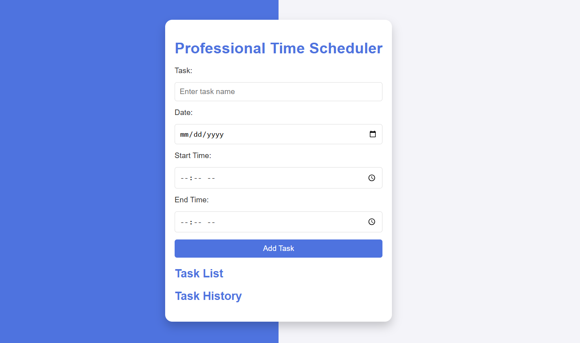

Title: Professional Time Scheduler
Presented by: Mufti Abbas
Date: 11/12/2024
Roll NO: 14725
Class: 3rd D (BScs)

Slide 2

Overview of the Project
The Professional Time Scheduler is a web-based task management application designed to help users manage their daily tasks efficiently. It supports task scheduling, reminders, and notifications using Flask for the backend and JavaScript for dynamic client-side functionality.

Slide 3

Introduction
The Professional Time Scheduler is a web-based application designed to help users organize and manage their daily tasks effectively. In today’s fast-paced world, managing time efficiently is crucial for personal and professional productivity. This application addresses this need by providing a platform where users can schedule tasks, set reminders, and receive notifications.
The project leverages modern web technologies, combining Flask for backend logic and JavaScript for dynamic frontend interactions. With features like task creation, alarm management, and real-time updates, the system ensures users stay on top of their responsibilities.

Slide 4

Objective:
The primary goal is to create an intuitive and efficient task management system that:
Simplifies task scheduling.
Automates reminders and alarms.
Provides real-time task updates.
Ensures task persistence through database integration.

Slide 5



Technologies Used
HTML,css
JS
Python Framework
.
.
Define the user interface layout and styling for responsiveness.
Manages UI interactivity (e.g., adding tasks, setting alarms).Sends AJAX requests to the backend for CRUD operations.
Manages API routes for creating, reading, updating, and deleting tasks.
Handles alarm scheduling logic and task state management.

Slide 6
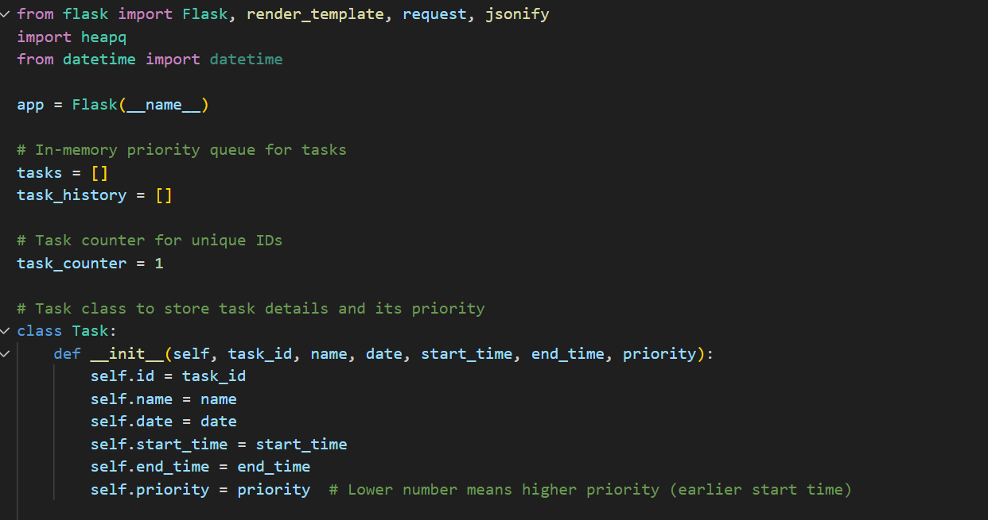
Code of project

Slide 7
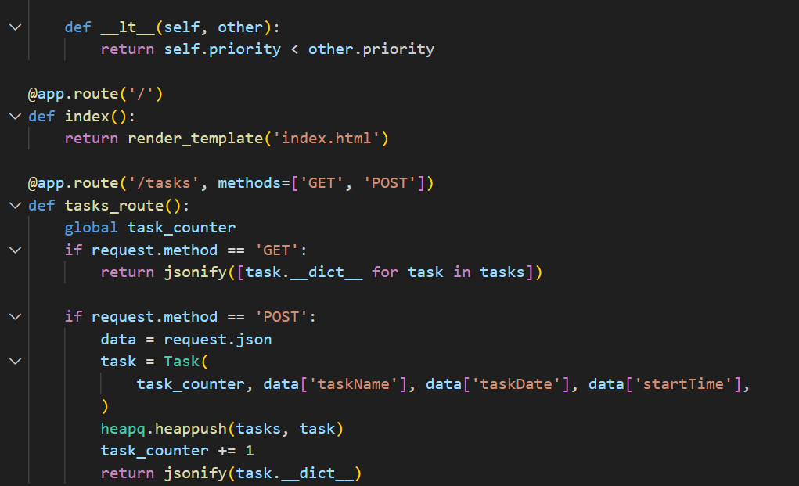
Code of project

Slide 8
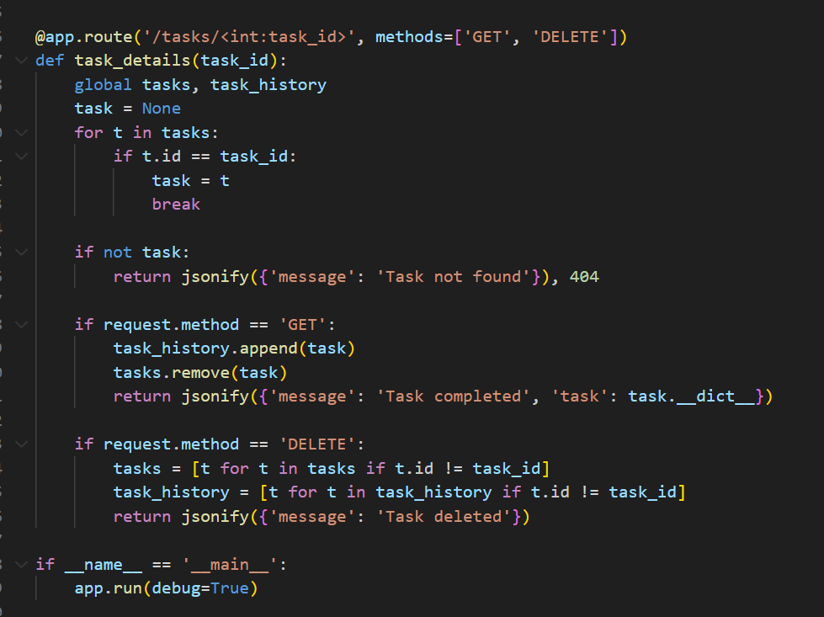
Code of project

Slide 9
UI Design

Slide 10

THANK YOU!

